Slide 1
Principles of management
Chapter-17
Managing Leadership and Influence Processes

Slide 2
Leadership
The action or activity of leading a group of people or an organization.
The ability to positively influence people and systems to have a meaningful impact and achieve results.
Leading People
Influencing People
Commanding People
Guiding People

Slide 3
Leaders
People who can influence the behaviors of others without having to rely on force.
People who are accepted as leaders by others.
A leader need not be a manager but a manager must have many of the qualities of a good leader?????

Slide 4
Power and Leadership
  Power is the ability to affect the behavior of others.
    Legitimate power is granted through the organizational hierarchy.
    Reward power is simply the power of a manager to give some type of reward to an employee as a means to influence the employee to act.
    Coercive power is the capability to force compliance by means of psychological, emotional, or physical threat.
    Referent power refers to the ability of a leader to influence a follower because of the follower's loyalty, respect, friendship, admiration, affection, or a desire to gain approval.
    Expert power is derived from the possession of information or expertise.

Slide 5
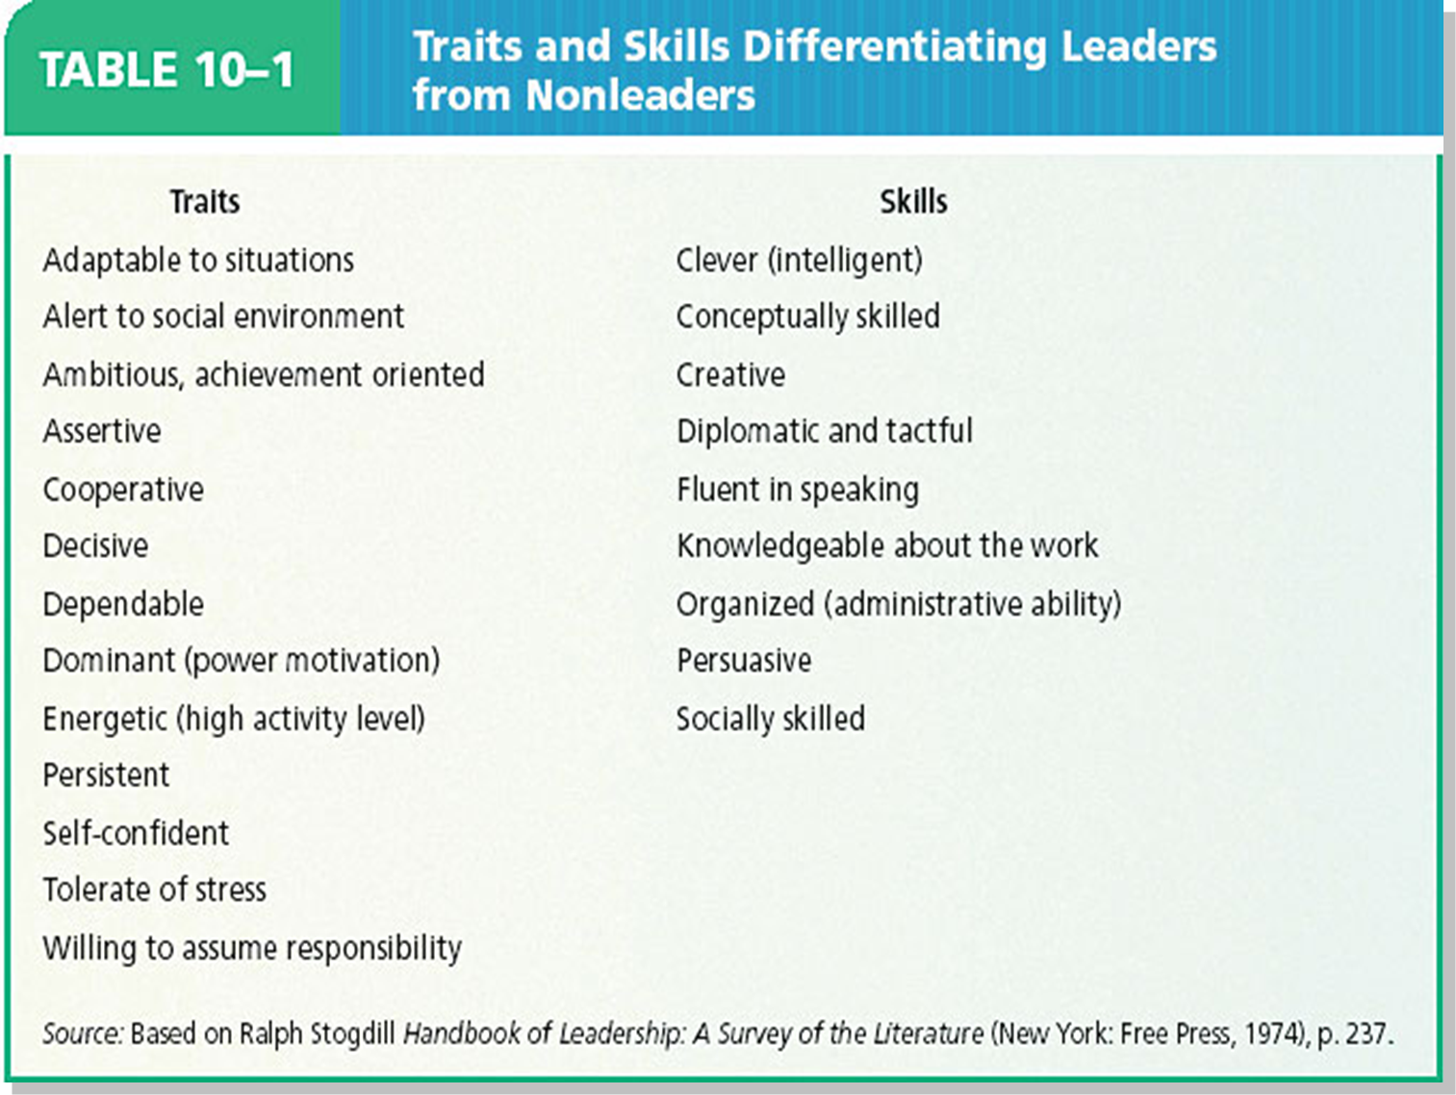

Slide 6
Leadership styles
Autocratic:
  Leader makes decisions without reference to anyone else
  High degree of dependency on the leader
  Can create de-motivation and alienation
  of staff
  May be valuable in some types of business where decisions need to be made quickly and decisively

Slide 7
Leadership styles
Democratic:
Encourages decision making from different perspectives – leadership may be emphasised throughout the organisation
  Consultative: process of consultation before decisions are taken
  Persuasive: Leader takes decision and seeks to persuade others that the decision is correct

Slide 8
Leadership styles
Laissez-Faire:
  ‘Let it be’ – the leadership responsibilities
  are shared by all
  Can be very useful in businesses
  where creative ideas are important
  Can be highly motivational,
  as people have control over their working life
  Can make coordination and decision making
  time-consuming and lacking in overall direction
  Relies on good team work
  Relies on good interpersonal relations

Slide 9
Leadership styles
Paternalistic:
Leader acts as a ‘father figure’
Paternalistic leader makes decision but may consult
Believes in the need to support staff

